Slide 1
Declarative Languages and Model Based Development of Web Applications
Besnik Selimi
South East European University
DAAD: 15th Workshop “Software Engineering Education and Reverse Engineering” Bohinj, Slovenia, 23-30 August 2015

Slide 2
Context
Development of web applications
Design Patterns
significant part of systematic work – producing the necessary code for applying the given pattern
Model-Driven Engineering (MDE)
ultimate goal - generate the code based on the model
web oriented teams frequently use agile methods
customers want a finalized product instead of a specification.

Slide 3
Motivation
The web
Full featured application platform.
Development has shifted to web and mobile
The content
precisely structured,
semantically meaningful and
available in an increasing number of different formats
Web content management
cannot be reduced to managing a set of pages, articles, or similar
covered by a multitude of Content Management Systems (CMS)

Slide 4
Motivation
CMS
rigid structure
difficult to customize data types and interfaces
Form generators
inherent linear structure
fixed database schemas
no programmatic customizations.
Most of web applications developed on a lower level, based on web framework libraries

Slide 5
Web frameworks
Cover the usual overhead in developing websites, web applications and services.
Set of libraries with common features
Reduce the amount of code to be written
Following suggested best practices
developers may even ignore important subtleties
HTTP protocol,
cookie and session management,
security, and
sometimes SQL

Slide 6
Web frameworks
Commonly accepted design patterns:
Model-View-Controller (MVC)
Active record (ORM)
Inversion of Control (IoC)
…
Despite libraries, there remains code that is produced systematically

Slide 7
Web frameworks
Hierarchy of documents
Examples:
article having a list of images or comments
researcher’s profile might include education, publication, work, and similar lists of records
For each list
separate tables
relate them with foreign keys
separate model classes
editing requires complex user interface
data sent to the server needs to be split to corresponding tables

Slide 8
Web frameworks
Managing hierarchies between models
categories, page hierarchies and similar.
adding database columns
provide support for editing relationships
models should verify that these relationships form a correct hierarchy
Avoiding complex solutions – suboptimal implementations

Slide 9
Web frameworks
Multilingual content
Localization is omnipresent
content translation: no systematic solutions
There are patterns
Manually specify additional tables or columns.
Managing/retrieving translations - a lot of code that is mere duplication.

Slide 10
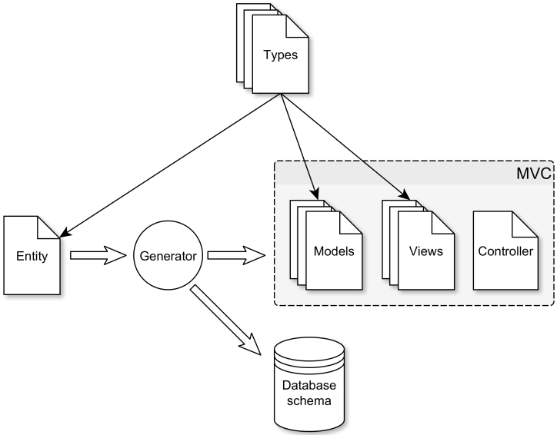
Approach

Slide 11
Specifications
Simple description of the structure of the data
Example of a study program
sufficient to present the model
compare this to an implementation

Slide 12
Entities
<entity id="Program" name="Study Program"> ... </entity>
id: for variable names (table, model class, form elements, …)
name: human-readable name for the UI

Slide 13
Fields
<entity ...> <field id="name" name="Name" type="String" /> ... </entity>
type:
store as a textual field in the database
Edit using standard HTML <input>

Slide 14
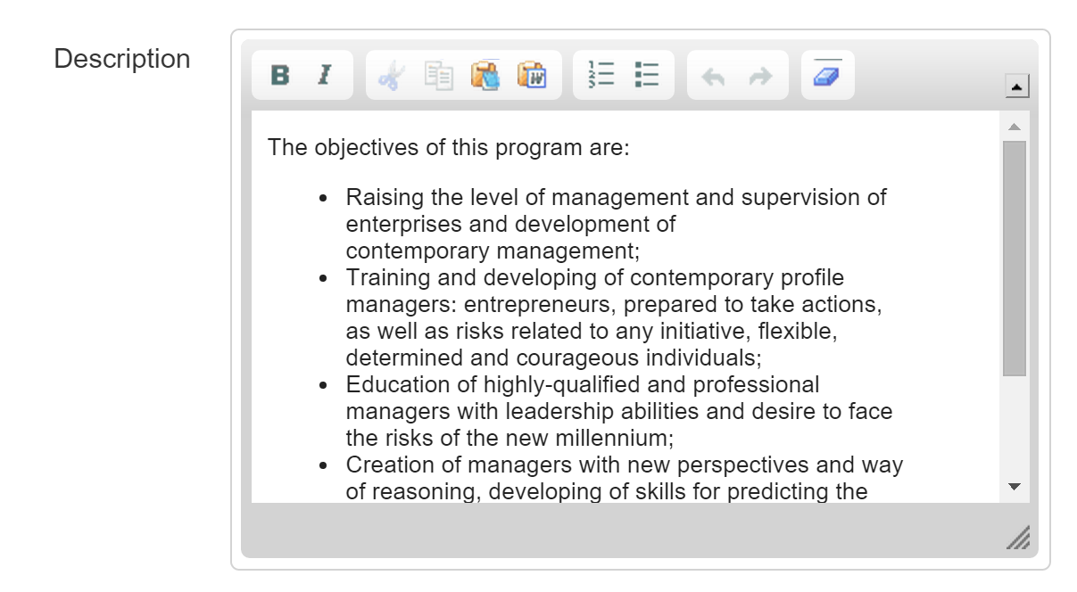
Types and Configuration
<field id="description" name="Description" type="RichText"> <param id="allowed_tags“ value="p,em,strong,i,b,..." /> </field>

Slide 15
Types and Configuration
<field id="ects" name="ECTS" type="Integer"> <param id="min" value="60" /> <param id="max" value="240" /> </field>

Slide 16
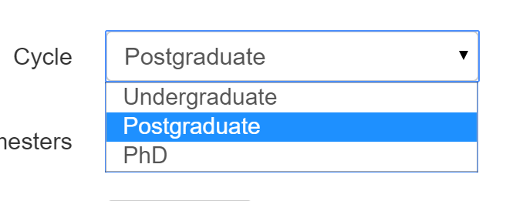
Types and Configuration
Parameters can be about anything, not only validation
<field id="Cycle" name="Cycle" type="Enumerated"> <param id="options"> <option value="undergraduate" name="Undergraduate"/> <option value="postgraduate" name="Postgraduate"/> <option value="phd" name="PhD"/> </param> </field>

Slide 17
Role of types
Provide a list of configuration parameters with default values
Parse the configuration parameters from the entity specification replacing the default values
Return the underlying storage type, based on its current configuration
Return a default value
Produce the HTML code for displaying its content
Produce the HTML form elements and necessary assets for editing such a field
Convert the data from and to the underlying storage type
Validate and adjust the data before saving

Slide 18
Level of types
FileUpload: uploading a file
Image: Upload and resize images
YouTube: for inserting links to videos
…
A form builder ???

Slide 19
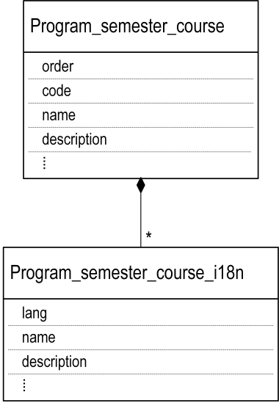
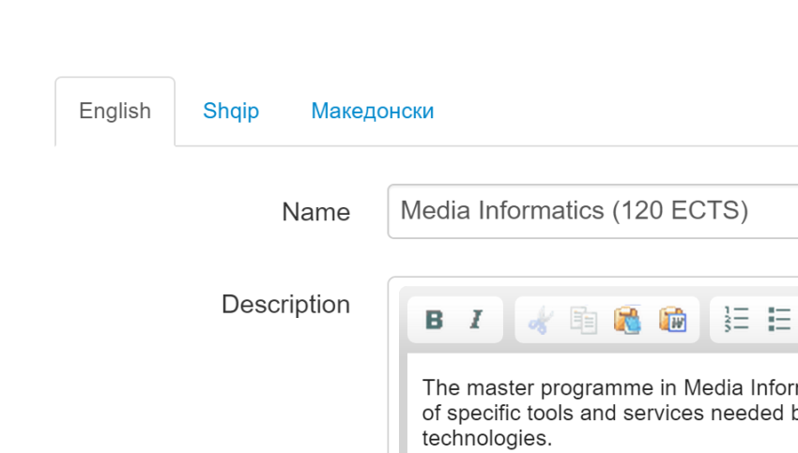
Multilingual fields
<field ... translate="true" />
Additional tables and models
Composition
Auto loading of current translations

Slide 20
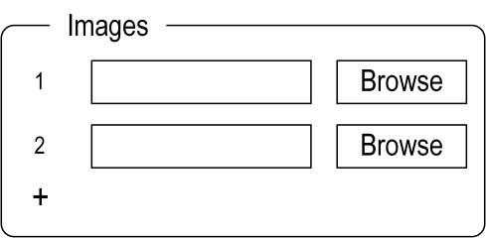
Repeatable fields
<field id="image" name="Images" type="Image" repeat="true" min-occurs="2" max-occurs="5"/>

Slide 21
Repeatable fields
<field id="image" name="Images" type="Image" repeat="true" min-occurs="2" max-occurs="5"/>
Program
Program_image
*
…
value

Slide 22
Optional fields
<field ... optional="true" />
Can be left empty
NULL field in the database
Not the same as repeating from 0 to 1 times

Slide 23
Groups
Group fields that conceptually belong together
Arbitrary level
Can also be repeated
<group id="semesters" name="Semesters" repeat="true" min-occurs="2" max-occurs="6"> <group id="courses" name="Courses" repeat="true"> <field id="name" name="Name" translate="true" type="String"/> ... </group> </group>

Slide 24
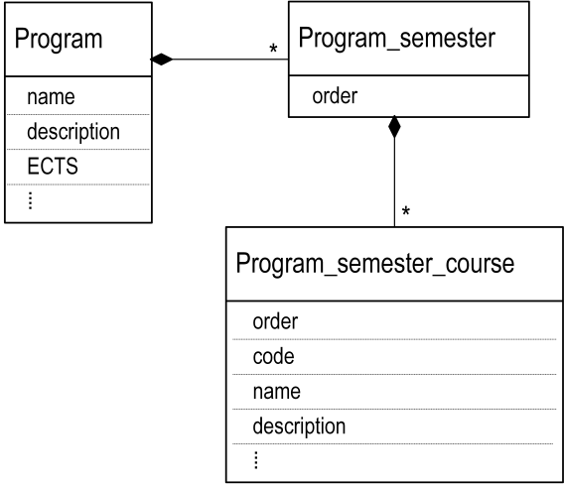
Groups

Slide 25
Relation fields
The only relationship with external entities (many-to-one)
Repeating produces many-to-many relationships
<belongsTo id="department" name="Department" entity="Department" />

Slide 26
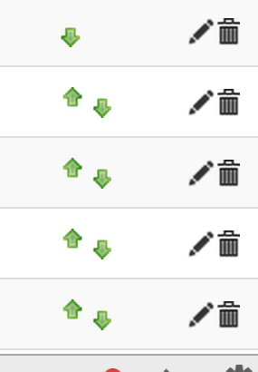
Hierarchy
Relationships among same entity records
<entity ... hierarchy="tree"> ... </entity>
ordered: add an order field, arrows for rearranging
tree: Nested-Set, add left, right and level fields, add a parent field in the form

Slide 27
Automatic fields
<field id="modified" name="Modified" type="Modified" /> <field id="created" name="Created" type="Created" />

Slide 28
Other aspects
Querying for records / usual ActiveRecord
Designing entities with drag-and-drop
Entity evolution and data migration?
Using NoSQL storage
XML Schema, UML, …

Slide 29
Conclusions
Identify systematic and repetitive tasks based on best practices.
Abstract these into a specification
Important concerns:
specifying the hierarchy of the internal structure of the content;
managing multi-lingual content;
using rich, extensible and reusable higher-level data types;
…

Slide 30
Conclusions
Concrete database schemas
Generate code
Follows common design patterns
Allows further customizations using standard OOP techniques.
Additional types to handle complex data types
Requirement specification
advanced prototype out of the box
faster iteration cycles in RAD approaches.
Accommodate a large number of information systems

Slide 31
Future work
Provide a simplified workflow model attached to entities
Validation rules depending on the state
Store a complete history of changes to a given document
Generation of RESTful services
Starting point for adding semantic annotations to content
Straightforward xample: microformat

Slide 32
Thank you
Questions?

